Slide 1
Data Mining DS-303
Lecture 6
Muhammad Arham
Lecturer
The University of Faisalabad

Slide 2
Content
Apriori Algorithm

Slide 3
Apriori Algorithm

Slide 4
Introduction to APRIORI
Apriori is the most famous frequent pattern mining method. It scans dataset repeatedly and generate item sets by bottom-top approach
Apriori algorithm is given by R. Agrawal and R. Srikant in 1994 for finding frequent itemsets in a dataset for Boolean association rule. Name of the algorithm is apriori because it uses prior knowledge of frequent itemset properties.

Slide 5
Cont…
This small story will help you understand the concept better. You must have noticed that the local vegetable seller always bundles onions and potatoes together. He even offers a discount to people who buy these bundles.
Why does he do so? He realizes that people who buy potatoes also buy onions. Therefore, by bunching them together, he makes it easy for the customers. At the same time, he also increases his sales performance. It also allows him to offer discounts.
Similarly, you go to a supermarket, and you will find bread, butter, and jam bundled together. The idea is to make it comfortable for the customer to buy these three food items in the same place.
The Walmart beer diaper parable is another example of this phenomenon. People who buy diapers tend to buy beer as well. The logic is that raising kids is a stressful job. People take beer to relieve stress. Walmart saw a spurt in the sale of both diapers and beer.
These three examples listed above are perfect examples of Association Rules in Data Mining. It helps us understand the concept of apriori algorithms.

Slide 6
What is the Apriori Algorithm?
Apriori algorithm, a classic algorithm, is useful in mining frequent itemsets and relevant association rules. Usually, you operate this algorithm on a database containing a large number of transactions. One such example is the items customers buy at a supermarket.
It helps the customers buy their items with ease, and enhances the sales performance of the departmental store.
This algorithm has utility in the field of healthcare as it can help in detecting adverse drug reactions (ADR) by producing association rules to indicate the combination of medications and patient characteristics that could lead to ADRs.

Slide 7
Apriori algorithm - The Theory
Three significant components comprise the apriori algorithm. They are as follows.
Support
Confidence
Lift
This example will make things easy to understand.
As mentioned earlier, you need a big database. Let us suppose you have 2000 customer transactions in a supermarket. You have to find the Support, Confidence, and Lift for two items, say bread and jam. It is because people frequently bundle these two items together.
Out of the 2000 transactions, 200 contain jam whereas 300 contain bread. These 300 transactions include a 100 that includes bread as well as jam. Using this data, we shall find out the support, confidence, and lift.

Slide 8
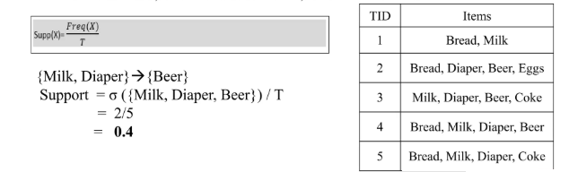
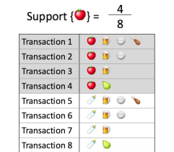
Support
Support is the frequency of A or how frequently an item appears in the dataset. It is defined as the fraction of the transaction T that contains the itemset X. If there are X datasets, then for transactions T, It can be written as

Slide 9

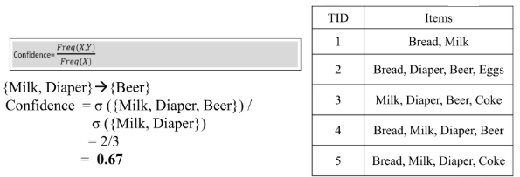
Confidence
Confidence indicates how often the rule has been found to be true. Or how often the items X and Y occur together in the dataset when the occurrence of X is already given. It is the ratio of the transaction that contains X and Y to be number of records that contain X.

Slide 10


Lift
It is the strength of any rule, which can be defined as below formula:
It is the ratio of the observed support measure and expected support if X and Y are independent of each other. It has three possible values:
If Lift =1: The probability of occurrence of antecedent and consequent is independent of each other.
Lift>1: It determines the degree to which the two itemset are dependent to each other.
Lift<1: It tells us that one item is a substitute for other items, which means one item has a negative effect on another.

Slide 11
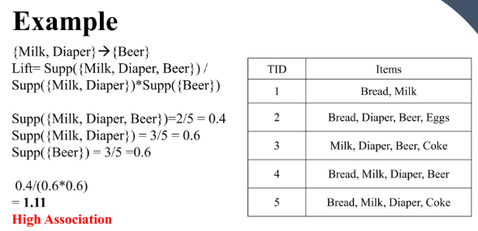

Slide 12
How does the Apriori Algorithm in Data Mining work?
We shall explain this algorithm with a simple example.
Consider a supermarket scenario where the itemset is | = {Onion, Burger, Potato, Milk, Beer}. The database consists of six transactions where 1 represents the presence of the item and 0 the absence.

Slide 13
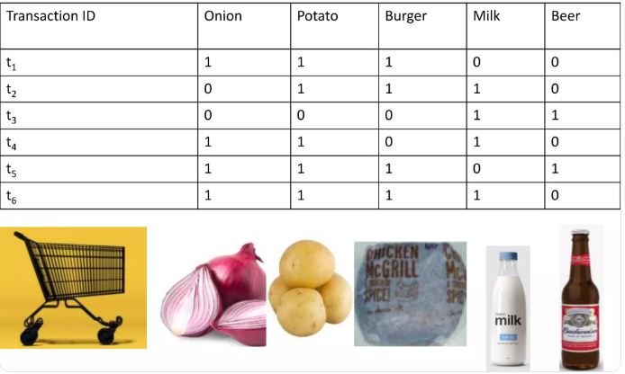
Cont…

Slide 14
Cont…
The Apriori Algorithm makes the following assumptions
All subsets of a frequent itemset should be frequent.
In the same way, the subsets of an infrequent itemset should be infrequent.
Set a threshold support level. In our case, we shall fix it at 50%

Slide 15
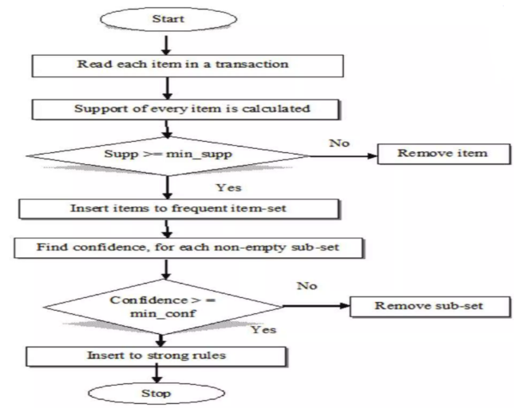

Slide 16
Steps
Create a frequency table of all the items that occur in all the transactions. The frequency table to include only those items having a threshold support level over 50%.
We arrive at this frequency table.
Threshold support >= 50%

Slide 17
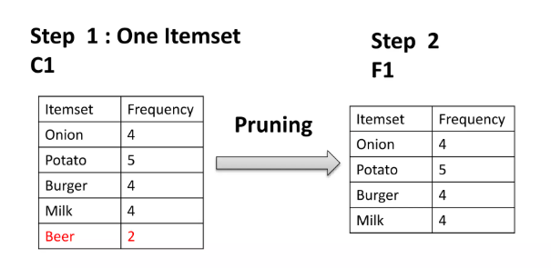
Steps

Slide 18
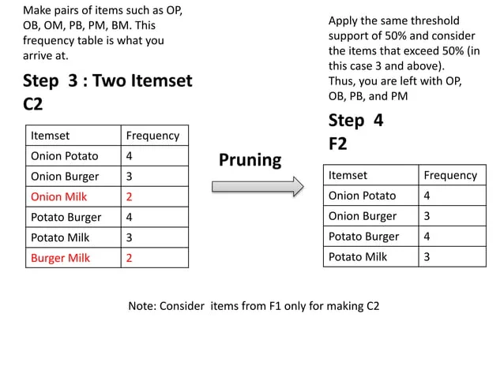

Slide 19
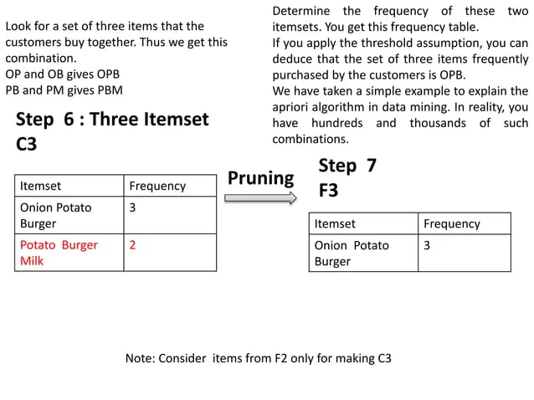

Slide 20
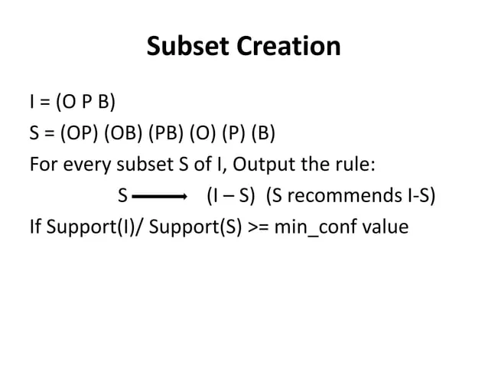

Slide 21
Apriori Algorithm - Pros
Easy to understand and implement
Can use on large itemsets
Apriori Algorithm - Cons
At times, you need a large number of candidate rules. It can become computationally expensive.
It is also an expensive method to calculate support because the calculation has to go through the entire database.
Apriori Algorithm - Limitations
The process can sometimes be very tedious.

Slide 22
How to Improve the Efficiency of the Apriori Algorithm?
Use the following methods to improve the efficiency of the apriori algorithm.
Transaction Reduction - A transaction not containing any frequent k-itemset becomes useless in subsequent scans.
Hash-based Itemset Counting - Exclude the k-itemset whose corresponding hashing bucket count is less than the threshold is an infrequent itemset.
There are other methods as well such as partitioning, sampling, and dynamic itemset counting.

Slide 23
Reference
https://www.slideshare.net/slideshow/apriori-algorithm-241228738/241228738#3
https://www.slideshare.net/slideshow/apriori-algorithmpptx/251719626

Slide 24
Advice
Kindly read the book before and after the lecture, if some terms/ words are not covered in the lecture, if appear in exam it might not appear strange or out of course.

